Slide 1
Last Update: 1/19/2023
Innovation Ambassador Program
Reference Deck
Innovation Ambassador Questions?
Contact Program Manager:
Phil Swaney
philip.Swaney@vanderbilt.edu

Slide 2
Innovation Ambassador Program Goals
Provide a peer-to-peer, department-level contact and direction for Vanderbilt innovators
Deliver innovation- and entrepreneur-related news to the departments
Provide feedback to administrative units on opportunities for improvement in the innovation space
Engage with other Ambassadors & VU/VUMC leadership on innovation efforts across campus

Slide 3
Ambassador Resource Topics
Intellectual property protection and commercialization
Vanderbilt technology transfer & IP policy
Entrepreneurship resources and Wond’ry tour
Startup support services and Launch incubator tour
Vanderbilt COI process
Special topics (e.g., AI commercialization, emerging trends in startup funding, etc…)
Supported by:

Slide 4
Innovation at Vanderbilt
High Innovation Capacity
Entrepreneurship Growth
Five-year summary ending in 2022:
“Global Outstanding Emerging Entrepreneurship Center of the Year” (Global Consortium of Entrepreneurship Centers)
Wond’ry NSF I-Corps Site recognized leader amongst peers
ideas supported by the Wond’ry annually
microgrants awarded totaling >$120,000
attendees at Makerfaire
of teams are led by women
in external funding for Wond’ry-related startups
recently launched incubator services
~50
Startups w/ Vanderbilt IP and equity stake launched
in licensing revenue
in industry funding for innovation research through CTTC-supported licenses
patents awarded
invention disclosures
Reuters Top 15 Most Innovative Universities in the U.S. 3 years running
Promising regional growth
>$150M
~$100M
>300
~350
61
>4000
~900
46%
>$35M
Supported by:
Supported by:

Slide 5
CTTC & Industry Collaborations
CTTC Questions?
Contact Alan Bentley
alan.bentley@vanderbilt.edu
Industry Collaborations Questions?
Contact Chris Rowe
chris.rowe@vanderbilt.edu

Slide 6
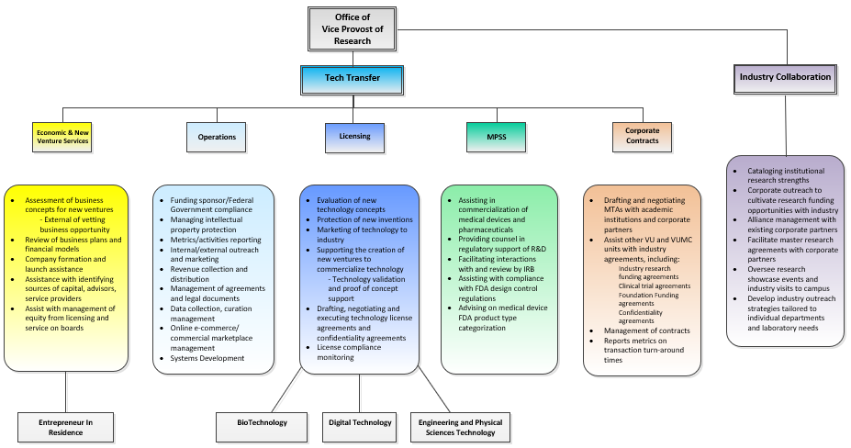
CTTC Office Structure and Personnel

Slide 7
CTTC Faculty Services
CTTC Foci
License
inventions to industry
Help launch
new start-up companies
Business
development/
Industry
engagement
Research
support & compliance

Slide 8
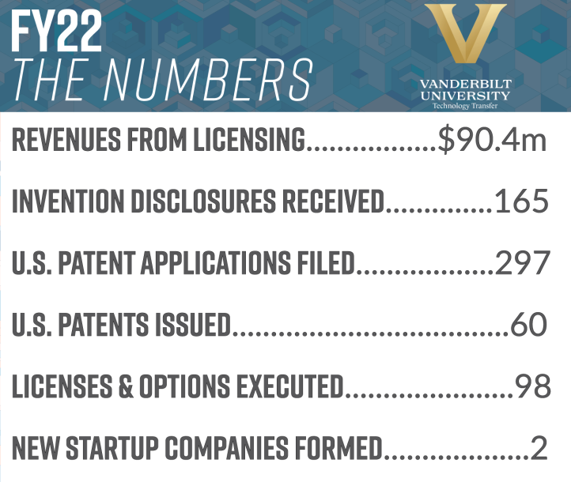
CTTC Impact

Slide 9
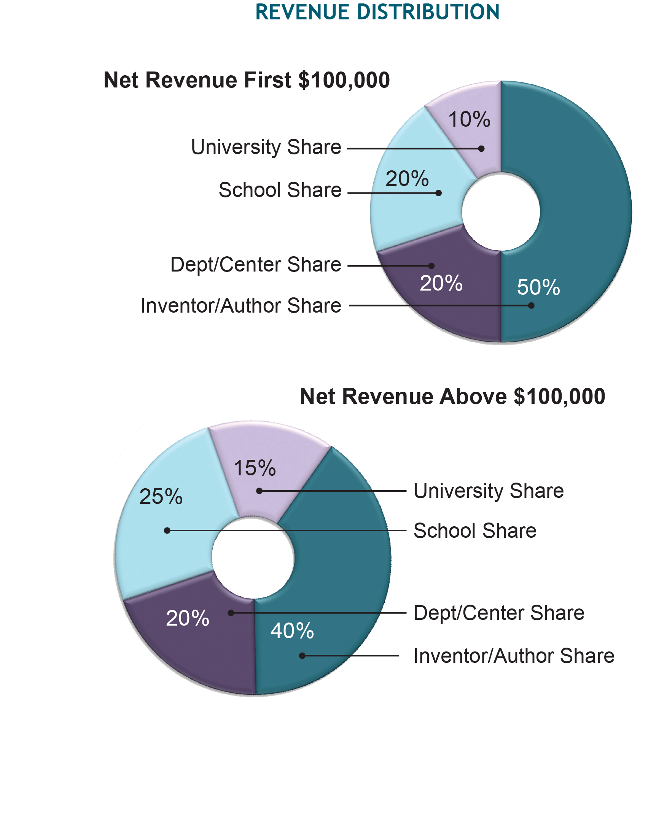
Vanderbilt IP Policy
Policy on Technology and Literary and Artistic Works, applies to both VU and VUMC employees
Faculty and staff have obligation to disclose
Discerns between scholarly (owned by author) and non-scholarly works
Vanderbilt owns Technologies created:
Within scope of employment
With Significant Use of University Resources (facilities or funds administered by VU)
Works-for-hire
CTTC has responsibility for protection and licensing of Vanderbilt IP assets
Proceeds from licensing distributed according to policy
If technology is not pursued by CTTC, inventors may request assignment of the rights

Slide 10
Why should researchers disclose?
Federal Government requires reporting of Federally funded inventions
Vanderbilt requires disclosure as a condition of employment
Discoveries that can help people and make a difference will rot on the vine without disclosure, protection and commercialization
VU employees have a financial incentive – 40% of revenues from licensing inventions flow back to inventors

Slide 11
Obligations under Federal Grants
Investigators and institutions have an obligation to report inventions to the federal government, and to grant the Government a free license to use for Government purposes
OCM manages this in annual reports and grant close out reports
CTTC reports inventions (better match OCM’s reports!), as well as election of title, patent filings, and utilization
CTTC includes “reservation of rights clause for US Government” in license agreements, and reports government funding on face of patent applications

Slide 12
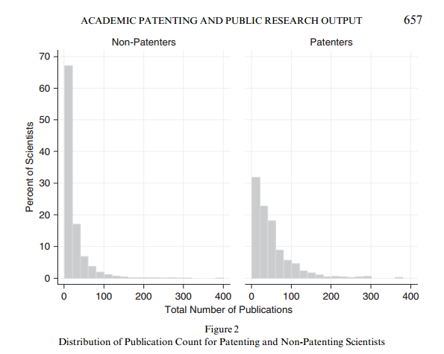
Patenting and Publishing
“Inventors publish significantly more than their colleagues who work in similar fields and who have similar career characteristics.”
Van Looy B., K. Debackere and J. Callaert, 2006, “Publication and Patent Behaviour of Academic Researchers: Conflicting, Reinforcing or Merely Co-existing”, Research Policy 35, 596-608.
“Patenting has a positive effect on the rate of publications”
Azoulay, P., W. Ding and T. Stuart, 2009, “The Impact of Academic Patenting on the Rate, Quality, and Direction of (Public) Research”, The Journal of Industrial Economics, 57(4), 637-676.
Academic inventors “publish more and better quality papers than their non-patenting colleagues”
Breschi, S., F. Lissoni and F. Montobbio, 2008, “University patenting and scientific productivity. A quantitative study of Italian academic inventors”, European Management Review 5, 91-110

Slide 13
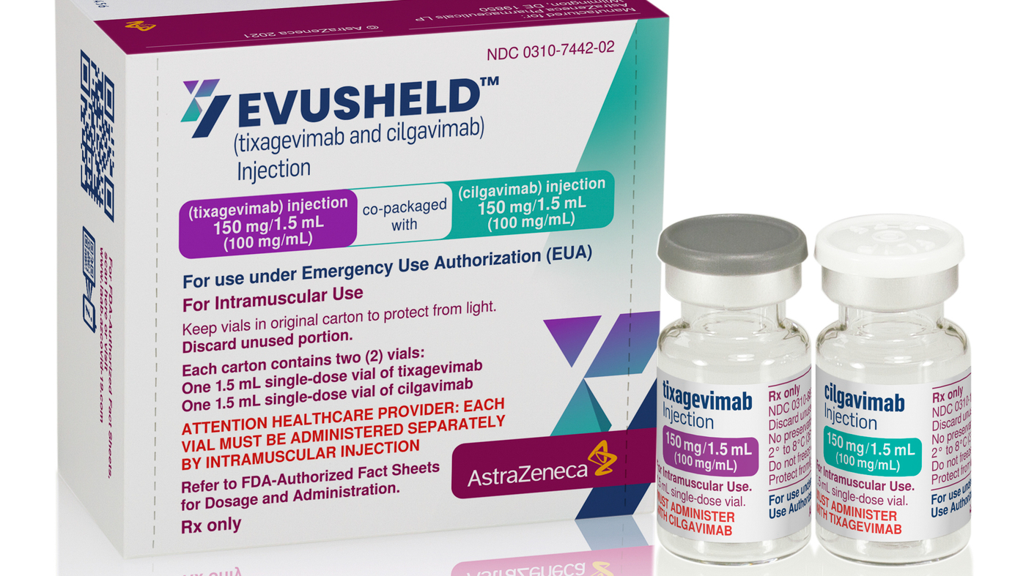
Recent Commercialization Success
AstraZeneca – COVID-19 antibody therapeutics, EUA granted by the FDA. Over 1 million courses administered. Single-digit royalty to Vanderbilt with $1.5B YTD sales as of 12/22
Read 180® – Comprehensive reading aid system. Sold by Houghton Mifflin Harcourt, Inc. Multi-million dollar transaction.
Parker Hannifin – Wearable exoskeleton for paraplegics, licensed to Parker Hannifin. Marketed as Indego®.
Neumora – License agreement for potential Schizophrenia therapeutic, possibility of >$1B in sales long term.
nPhase – Commercial development of REDCap for clinical trial management. Vanderbilt major stockholder.

Slide 14
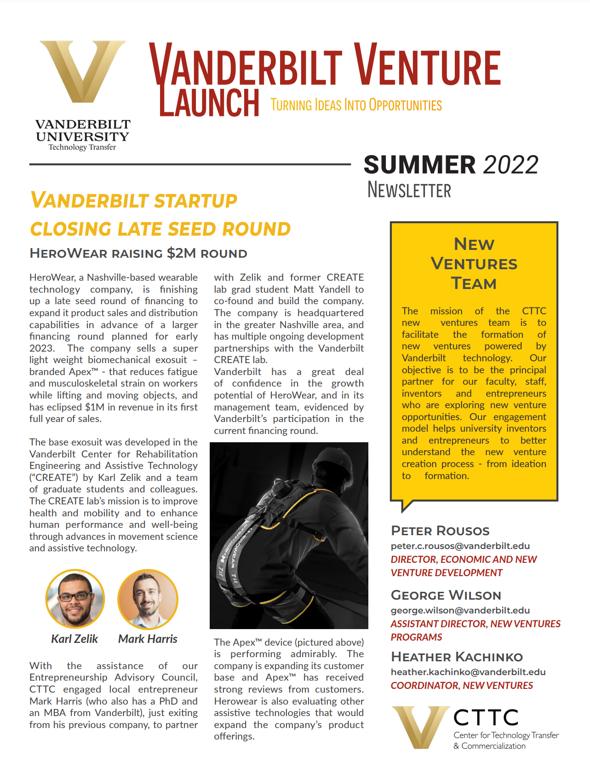
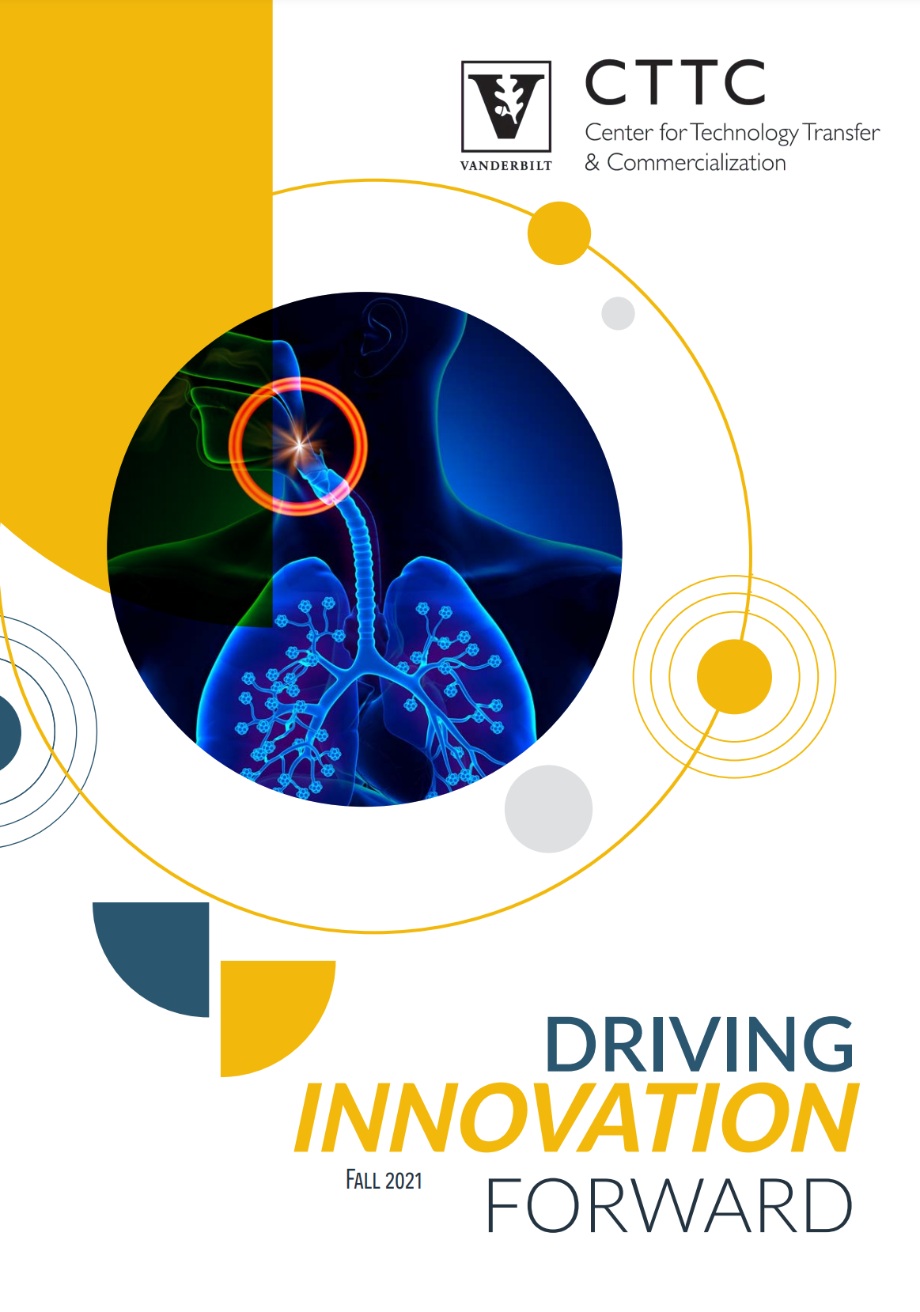
CTTC Publications & Communications
Monthly, CTTC updates
Quarterly, new venture updates
Yearly, CTTC highlights

Slide 15
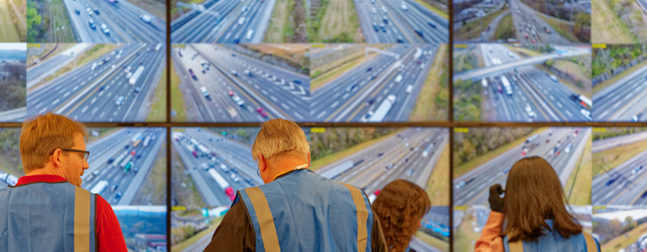
Industry Collaborations
MISSION
Identifies, supports and stewards corporate research and development partnerships across the university
Supports Industry R&D programs and projects
ECOSYSTEM
CTTC
Sponsored Programs Administration
Core Facilities
The Wond’ry
Brock Center
Corporate Advancement and Engagement
Research Centers and Institutes
Faculty and Administrators across university

Slide 16
Industry Collaborations Priorities
01
“Single Front Door” into Vanderbilt’s R&D ecosystem with liaisons to act as facilitators within network
02
Focus on industry partnerships, remove barriers and build our pipeline
03
Work collaboratively across campus to maximize effectiveness of each partnership

Slide 17
Industry Collaborations & CTTC

Slide 18
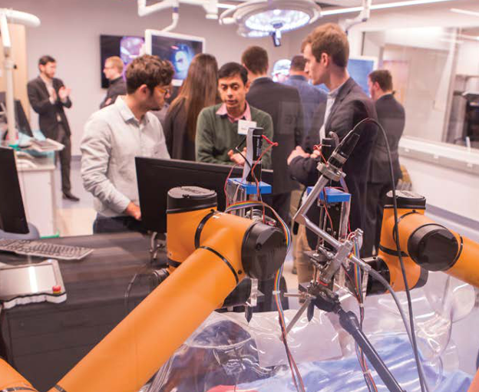
R&D Corporate Partnerships
Establish new long-term, comprehensive partnerships
Administer, nurture, and augment current partnerships
Support close interactions with academic division leadership, faculty, research groups, and centers
Establishes and facilitates communication pathways between the PI and company
Partners with the university research ecosystem
Maintains open lines of communication and mutual support with CTTC to leverage broader resources for robust corporate and industry partnerships

Slide 19
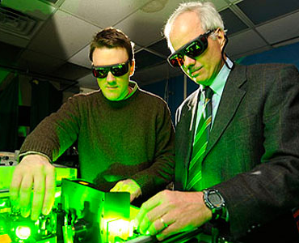
Research Identification
Assesses each partner's R&D strategy and technology needs
Identifies university research strength and interests
Ascertains faculty 'best fit' for project
Facilitates discussions between company and PI
Guides proposal development
Expedites the pre-award and project implementation processes

Slide 20
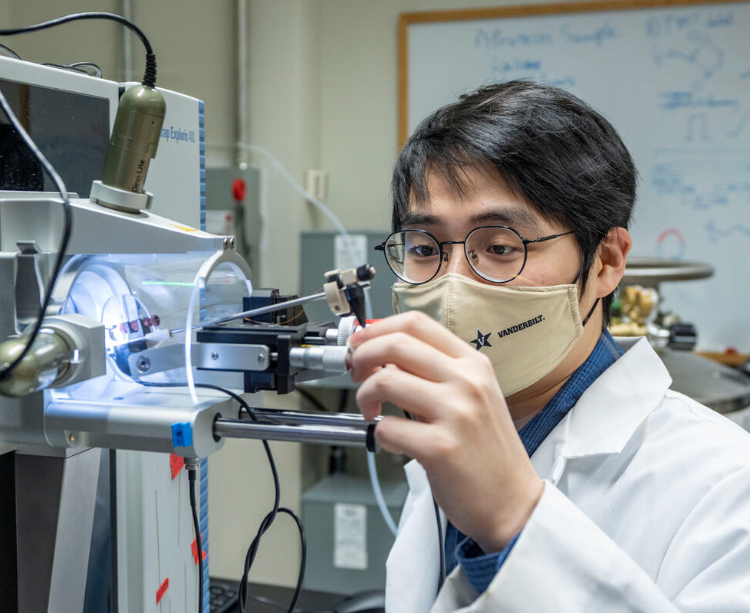
Innovation/Research Ecosystem
Partners with the university research ecosystem
Maintains open lines of communication and mutual support with CTTC to leverage broader resources for robust corporate partnerships
‘On call' to remove any administrative burdens
Connect corporate partners with Career Advancement & Engagement for potential internships and career paths for students

Slide 21
Wond’ry & VentureStudio Startup Support
Wond’ry Questions?
Contact Charleson Bell
c.s.bell@vanderbilt.edu
VentureStudio Questions?
Contact Peter Rousos
peter.rousos@vanderbilt.edu

Slide 22
New Ventures Continuum – Participants
Wond’ry
CTTC
Venture Fund
Accelerator
Owen/Center For Entrepreneurship
Front Door Connectivity
New Company
Vetting/Validation
Investment Due Diligence
Subsidized Company
Space
Firestarter Pitches
Education Programming
Company Formation
Seed Investments
Subsidized Laboratory Space
Sohr Grant
Maker Space
Commercialization
Syndicated Series-A Investments
Boot Camp Programming
Entrepreneur Conferences
Mentorship
Capitalization
Investor Networking
Demonstration/Pitch
Events
Acting CEO Program (w/ CTTC)
Microgrant Funding
Trans-Institutional Programming
Syndication
Talent Recruitment
Customer Discovery
Asset Management & Administration
SOM
VUMC
Law School
Office Space/Incubation
Aspire to Innovate & Enabling Innovation
Brock Family Center for Applied Innovation
Startup Law Clinic

Slide 23
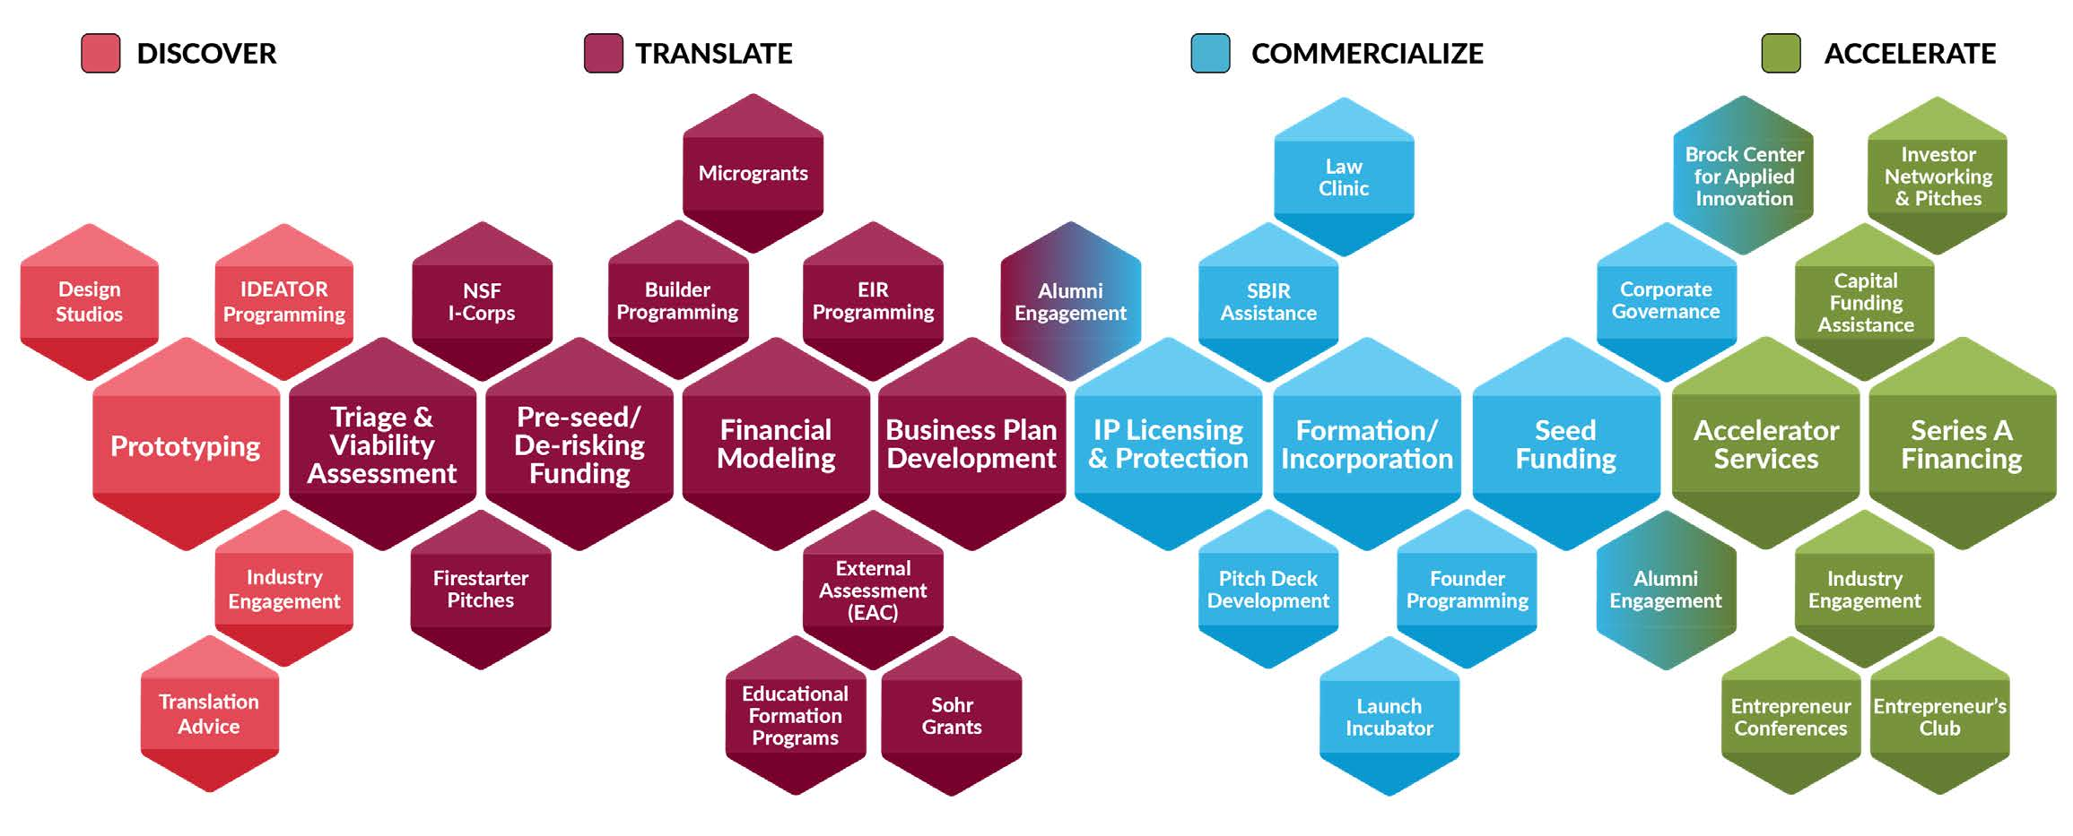
New Ventures Continuum – Stages

Slide 24
Vanderbilt’s Dynamic Innovation Ecosystem
VU Pre-Seed Funding
INCITE Investment Fund
Pitch Deck Development
INCITE Investment Fund
Wond’ry Ideator Program
Wond’ry Makerspace
SBIR Drafting Grants
SOHR Grants
VUMC- Brock Center Business Consults
CTTC Triage & Bus Model Development
Technology
Advancement
Business Viability Assessment
Brock Center
POC Fund
SBIR Matching Fund
Capitalization/
Investments
Firestarter Pitches
External Advisory Council Assessment
Wond’ry Microgrant Program
Wond’ry Design Studio
Investor Network Access
Entrepreneur Conferences
Wond’ry I-Corps Program
Wond’ry Translation Advise
Technology Maturation
VU Series A Fund (soon)
VUMC – Brock Center Seed Funding
VU Seed Fund (soon)
IP Lectures
IP Awareness, Protection, & Licensing
IP Evaluation & Protection
Entrepreneurship
School Courses
Financial Modeling
Business Model Development
Corporate Governance
IP Genius Bar
Start-up Friendly Licensing Terms
Operational Support
Wond’ry Launch Incubator
CTTC EIR
Program
Business
Launch &
Growth
Education & Mentorship
Formation/ Incorporation Assistance
Brock/EI2
Lecture Series
Wond’ry Founder Program
Brock Center – EIR Executive Mgmt.
Launch TN
Mentor Networks
Wond’ry Nuilder Program
Workforce Development
Additional Resources
Corporate Partnership Development
Talent Recruitment
Wond’ry Mentor Program
Alumni Engagement
Entrepreneur’s Club/Network
Accelerator Services (soon)
Shared Wetlab Space (soon)
Regional Graduation Space (soon)
Notes:
Main idea: this is a lot to navigate a changing landscape as Vanderbilt makes investments into the ecosystem. Stewards will stay up-to-date with these efforts and guide faculty through the internal process as well as external opportunities.

Slide 25
Vanderbilt New Venture Model Highlights
Seed
Funding
Pre-Seed
Development
Funds
Alumni Engagement
“Start-up Friendly” License Terms
VU
Institutional
Support
Business & Financial Planning
School/ Dept
Programming
Shared
Wetlab
Space
CTTC Services
Prototyping
Accelerator
Services
Mentor
Networks
Investor
Networks
Wond’ry
Education
Incorporation
Assistance
Microgrant
Funds
EIR
Program
Coming Soon

Slide 26
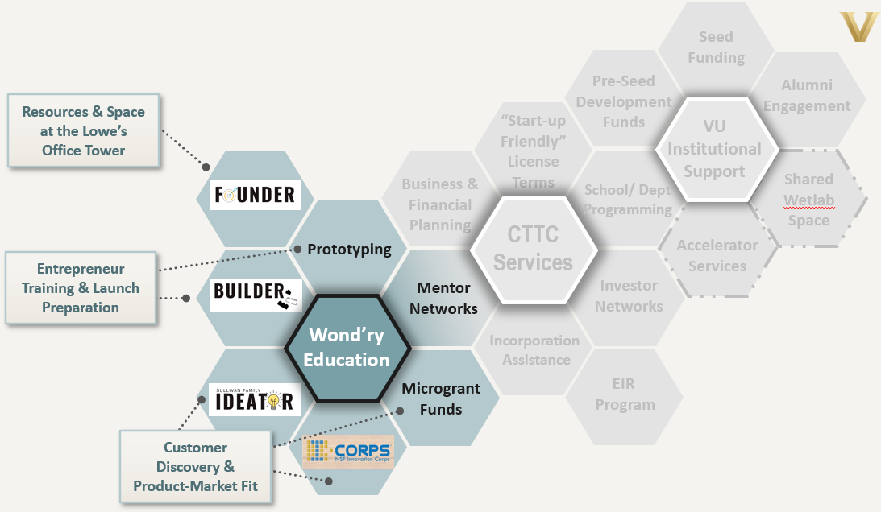
Vanderbilt New Venture Model Highlights : Wond’ry
Highlights
Makerspaces
NSF I-Corps programming and customer discovery
Mentoring
Office/dry-lab space
Educational programming
Customer discovery assistance
Company launch assistance

Slide 27
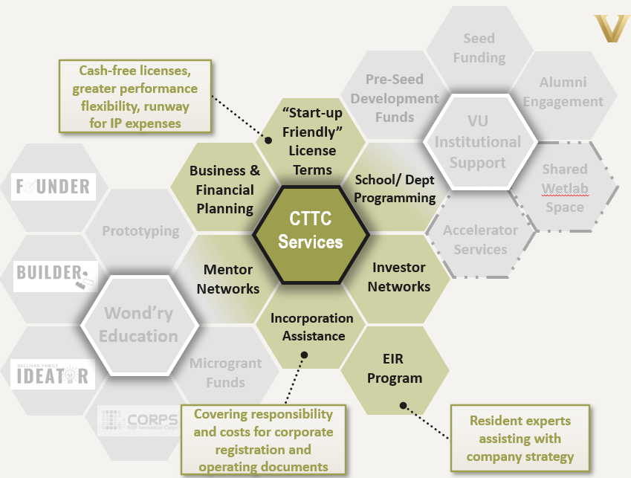
Vanderbilt New Venture Model Highlights : CTTC
Highlights
Startup friendly licensing terms
External vetting of venture opportunities
Entrepreneur-in-residence assistance
Incorporation and registration assistance
Financial modeling
Financing assistance

Slide 28
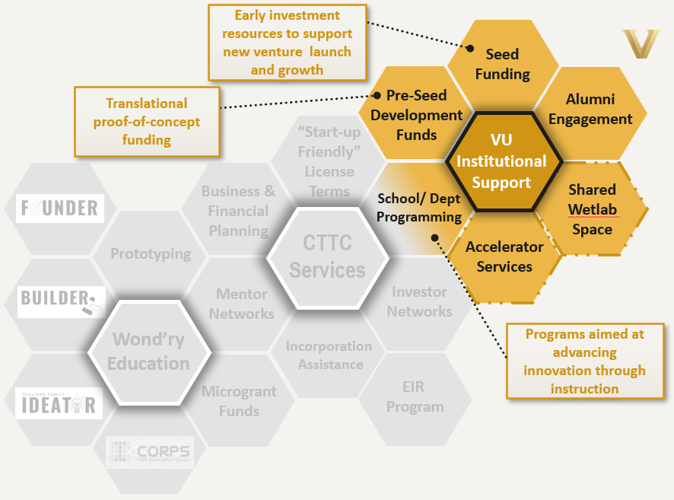
Vanderbilt New Venture Model Highlights : Institution
Highlights
Alumni engagement program
School programs for students
Pre-seed translational funds
Seed investment funds
Planned accelerator and wetlab facilities

Slide 29
Expanded Support Services Inclusive of Regional Programs
“Start-up Friendly” License Terms
Coming Soon
Business & Financial Planning
Investor
Networks
Accelerator
Services
Specialized
Mentor
Networks
CTTC Services
Regional Biotech Accelerator
Workforce
Development
Prototyping
Seed
Funding
Shared
Wetlab
Space
Regional
Programs
SBIR Drafting Assistance
Mentor
Networks
School/ Dept
Programming
Wond’ry
Programs
VU
Institutional
Support
Wetlab/
Graduation
Space
SBIR Matching Funds
Incorporation
Assistance
EIR
Program
Pre-Seed
Development
Funds
Capital Investment Funds
Microgrant
Funds
Alumni Engagement

Slide 30
Entrepreneurship Services
Venture Assessment
Venture Launch
Venture Growth
Inventor interview
Triage of new venture opportunity
External expert assessment
Financial modeling
Pitch Deck development
Entrepreneur vetting and recruitment
IP protection and licensing
Proof of concept and prototyping
Company formation
Board and talent recruitment
Pitch preparation
Investor engagement
Seed investment negotiations
SBIR assistance
Company incubation

Slide 31
CTTC Venture Studio - Entrepreneurship Services
Develop the Business Roadmap
Refine the financial model
Refine the business plan
Modify pitch decks for multiple uses
Company formation
Development of corporate documents
Registration of equity holdings
Board recruiting
Validation and Viability Testing
Staging
and Development
Formation
and
Governance
Capitalization and
Investments
Commercialization
Inventor interview
Triage of new venture opportunity
SWOT analysis
Evaluation of key business opportunity
EIR review
External (EAC) assessment
IP protection and patenting
Proof of concept and prototyping
Development of diligence plans
Technology licensing
Pitch deck refinement
VC pitch preparation
Investor engagement
Investment term sheet negotiations

Slide 32
CTTC Venture Studio - Institutional Services
Service on university and regional boards and committees
Partnerships with internal stakeholders and continuum participants
Regional Outreach & Engagement
Ecosystem Development
Strengthen regional networks
Collaborative programs and initiative
Contribute to community events
Contributions to innovation and entrepreneurship education
Institutional
Services
New Ventures newsletter and Driving Innovations Forward publication
Equity management assistance
Tech Connect newsletter
Startup metrics tracking
COI management assistance
Coordination of communications articles and press releases
Communications
& Recognition
Administrative Services
IP Policy revisions
Master innovator and entrepreneur recognition programs
Assistance with funding applications

Slide 33
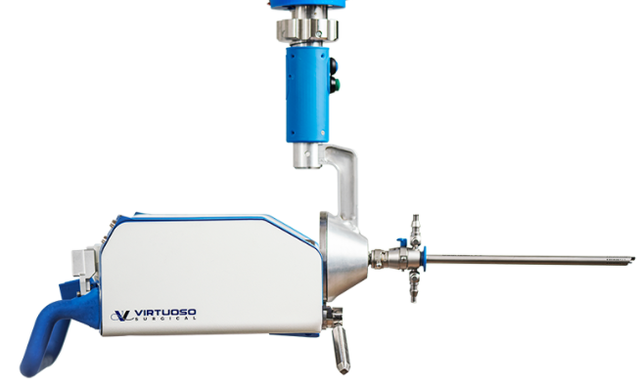
Recent new venture launches
Appello Pharmaceuticals
Vanderbilt PI: Drs. Jeff Conn and Craig Lindsley
Therapeutic for Parkinson’s Disease
Virtuoso Surgical
Vanderbilt PI’s: Drs. Bob Webster and Duke Herrell
Robotically-controlled endoscopic surgical system
HeroWear
Vanderbilt PI: Karl Zelik
Back-assist wearable exosuit
Abseek Bio
Vanderbilt PI: Ivelin Georgiev
Antibody discovery platform technology
See complete list of portfolio companies of CTTC website

Slide 34
Conflict of Interest
COI Questions?
Spruell Driver
Director
spruell.driver@vanderbilt.edu
(615) 875-8064
Alison Cooper
Associate Director
alison.r.cooper@vanderbilt.edu
(615) 322-8363
coi@vanderbilt.edu

Slide 35
Institutional Conflict of Interest
Institutional conflict of interest (“Institutional COI”) refers to:
Situations in which the financial interests of an institution or institutional official, acting within his or her authority on behalf of the institution, may affect or appear to affect the research, education, clinical care, business transactions, or other activities of the institution.
Institutional Financial Interests
Unbiased design, conduct, and reporting of research

Slide 36
Institutional Conflict of Interest
Who?
Everyone – All VU Faculty, Staff, and Postdocs
When?
Every year and ALSO when your circumstances change (within 30 days of a new significant financial interest)
Where?
Conflict Disclosure System
How?
Log-in with your VUNetID & password

Slide 37
Institutional COI resulting from License Agreements
Material Consideration
Any equity in a privately-held company
Equity in a publicly-held company of value in excess of $100,000
Licensing fee in excess of $100,000
Combination of licensing fees and publicly-traded equity with collective value in excess of $100,000

Slide 38
Institutional COI resulting from License Agreements
Research Related to Licensed Technology
Any research at Vanderbilt related to the licensed technology
Example: New venture sponsors research aimed at achieving license milestones that obligate payment of material consideration

Slide 39
Institutional COI from License Agreements
Human Subjects Research
Is human subjects research underway or planned at VU or VUMC?
COI Policy presumes that conflicted individual or institution shall not conduct human subject research.
Presumption is rebuttable.
University Conflicts Committee (UCC) will conduct risk/benefit analysis to see if there exists “compelling circumstances” to justify participation of conflicted individual or institution.
UCC may set forth specific conditions to mitigate potential for conflict.

Slide 40
COI Management Plans
Plans are put into place to limit the risks to the University and the faculty/staff member with the conflict. Some plans also protect the integrity of research.
Having a “conflict” does not necessarily mean an activity is prohibited. In most cases, all that is needed is a management plan.
Oversight of all management plans remains a duty of the Dean’s office.
Questions about implementation of a management plan may be brought to the COI Office at any time.

Slide 41
Typical Features of a Management Plan
Management Plan Implementation – Dean’s office
Annual External Review – party independent of Vanderbilt
Expertise in science of the project
Acceptable to the Dean or Dean’s designee
Signs confidentiality agreement and attestation of no pre-existing financial relationships
Reviews all materials deemed necessary to identify potential bias in the research
Interviews faculty, staff, and students involved in the research
Reviews publications and presentation descriptive of the research
Reviews business arrangements between Vanderbilt and new company
Report annually to the Dean and the COI Office
Annual Internal Oversight
Time and Effort
Students, Postdocs, and Trainees
Interested Parties
Public Disclosure

Slide 42
UCC and COI Office Responsibilities
University Conflicts Committee (UCC)
Reviews and manages complex COI matters:
Advises the COI Office on questions or policy and practice
Membership includes representatives from several departments throughout Vanderbilt
General Counsel serves as Chair of the Committee
Office of Conflict of Interest and Commitment Management (COI Office)
Oversees implementation of the COI Policy
Director reports to the General Counsel
Human subjects research when Investigator has significant financial interest (SFI)
Unmanageable conflicts
Institutional COI

